Slide 1
Reimbursement & Chrome River Training
Policy 6.12 – Direct Reimbursement of Permissible Expenditures
Chrome River Assistance – Employee Expense Reporting

Slide 2
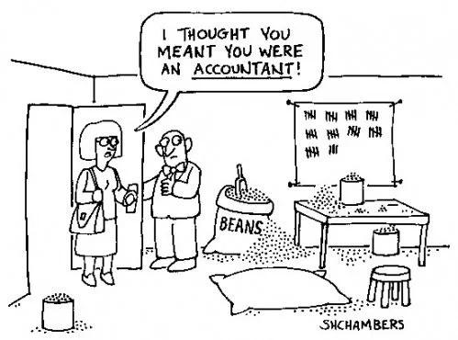
Source: 15 Jokes About Accountants (ignitespot.com)

Slide 3
Policy 6.12 – Direct Reimbursement for Permissible Expenditures
New Policy – Effective March 1, 2024
General Guidelines
Current Policy – Effective through February 29, 2024
General Guidelines
All employees must obtain appropriate approval before scheduling travel arrangements. Failure to obtain appropriate approval may result in the employee being responsible for all travel expenses.
Overnight or out-of-state travel on college business – required to submit an Advance Travel Request (ATR) with estimated expenses prior to travel.
Expenses for accompanying spouse or others are not reimbursable from the college.
The ATR can be found on the Finance Office website: Employee Resources - OTC Finance Department
All employees must obtain appropriate approval before scheduling travel arrangements.
Advance Travel Request (ATR) for overnight or out-of-state travel on college is currently not listed as a requirement.
Expenses for an accompanying spouse or others are not reimbursable from the college.

Slide 4
Policy 6.12 – Direct Reimbursement for Permissible Expenditures
New Policy – Effective March 1, 2024
General Guidelines
Current Policy – Effective through February 29, 2024
General Guidelines
Employees shall utilize the most economical method of transportation for travel considering the business purpose, dates/times, and college needs.
Reimbursement for expenses deemed excessive may be denied at the discretion of the supervisor, vice chancellor, and/or chancellor. Reimbursement of expenses not listed or that exceed those approved on the ATR may also be denied.
Employees are encouraged to use reasonable economies.
Reimbursement for expenses deemed excessive may be denied at the discretion of the supervisor and/or vice chancellor or president.

Slide 5
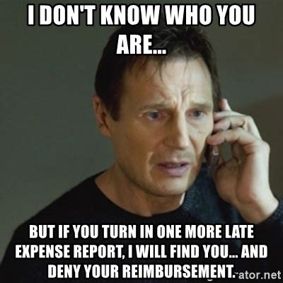
Source: Expense report Memes (memesmonkey.com)

Slide 6
Policy 6.12 – Direct Reimbursement for Permissible Expenditures
New Policy – Effective March 1, 2024
General Guidelines
Current Policy – Effective through February 29, 2024
General Guidelines
The Employee Expense Reimbursement should be submitted, with all receipts, to the Finance Office within 30 days of the completion of the trip. For grant-funded travel or travel funded with another non-college source(s), the reimbursement must be submitted within 30 days of the completion of the trip to ensure compliance with grant and other funding requirements.
For any direct expenditures or travel funded by grants (or other funding sources) with different restrictions, the more restrictive policy will be followed.
The Employee Expense Reimbursement should be submitted, with all receipts, to the Finance Office within 30 days of the completion of the trip.
For any direct expenditures or travel funded by grants (or other funding sources) with different restrictions, the more restrictive policy will be followed.

Slide 7
Policy 6.12 – Direct Reimbursement for Permissible Expenditures
New Policy – Effective March 1, 2024
Transportation
Current Policy – Effective through February 29, 2024
Transportation
The college shall reimburse the employee for the mode of transportation which is the most economical, considering the time and convenience of the transportation. The time of departure or shorter absence shall be an important factor to the college. Air travel reimbursement shall be for coach or economy class and a limit of one standard checked bag. Please note federal grants require travel by US carrier. Car rental or ridesharing services, while the employee is attending the business activity, may be an appropriate expenditure.
The college shall reimburse the employee for the mode of transportation which is the most economical, considering the time and convenience of the transportation. The time of departure or shorter absence shall be an important factor to the college. Air travel reimbursement shall be for coach or economy class. Car rental, while attending the business activity, may be an appropriate expenditure.

Slide 8
Policy 6.12 – Direct Reimbursement for Permissible Expenditures
New Policy – Effective March 1, 2024
Transportation
Current Policy – Effective through February 29, 2024
Transportation
When an employee drives their automobile on college business, they will be eligible for mileage reimbursement at the stated college reimbursement rate. The chief financial officer will set this rate at the beginning of the fiscal year to align with the Internal Revenue Service (IRS) standard mileage reimbursement rate. The college will calculate all mileage from the primary work site to the business activity and returning to the work site, unless actual mileage was less.
When an employee drives their automobile on college business, they will be eligible for mileage reimbursement at a rate not to exceed the Internal Revenue Service (IRS) standard miles rate, less 3 cents per mile. The college will calculate all mileage from the primary work site to the business activity and returning to the work site, unless actual mileage was less.

Slide 9
Policy 6.12 – Direct Reimbursement for Permissible Expenditures
New Policy – Effective March 1, 2024
Transportation
Current Policy – Effective through February 29, 2024
Transportation
Employees temporarily (less than 12 months) assigned to work at one or more locations, may be reimbursed for the additional mileage incurred over and above the normal round trip from home to the primary work site.
Employees working in two or more locations in one day may be reimbursed for mileage getting from one location to another.
Mileage between a residence and the primary work site(s) is considered commuting mileage by the IRS and is not reimbursable.
Employees, when assigned to more than one location, may be reimbursed for the additional mileage incurred over and above the normal round trip from home to the primary work site.
New policy provides specific detail for two or more locations.
New policy addresses commuting mileage.

Slide 10
Policy 6.12 – Direct Reimbursement for Permissible Expenditures
New Policy – Effective March 1, 2024
Transportation
Current Policy – Effective through February 29, 2024
Transportation
Mass transit, shuttles, taxis/ridesharing services, bridge and road tolls, or parking charges incurred while on official business may be claimed when properly itemized on the travel expense voucher. Itemized receipts must be submitted for reimbursement, wherever possible.
Mass transit, shuttles, taxis/ridesharing services, bridge and road tolls, or parking charges incurred while on official business may be claimed when properly itemized on the travel expense voucher. Itemized receipts must be submitted for reimbursement, wherever possible.

Slide 11
Policy 6.12 – Direct Reimbursement for Permissible Expenditures
New Policy – Effective March 1, 2024
Lodging
Current Policy – Effective through February 29, 2024
Lodging
The number of nights is limited to those necessary for attendance at the conference or business activity.
A reasonable number of additional nights will be allowed if necessary to take advantage of discounted airfares, though this must be noted on the ATR with the necessary approvals. An itemized receipt for all lodging must be attached to the travel expense voucher. Sales tax at Missouri hotels is not an allowable expense, as the college is exempt from Missouri sales tax. Hotel receipts must show a zero balance.
The number of nights is limited to those necessary for attendance at the conference or business activity.
A reasonable number of additional nights will be allowed if necessary to take advantage of discounted airfares. An itemized receipt for all lodging must be attached to the travel expense voucher. Sales tax at Missouri hotels is not an allowable expense, as the college is exempt from Missouri sales tax. Hotel receipts must show a zero balance.

Slide 12
Policy 6.12 – Direct Reimbursement for Permissible Expenditures
New Policy – Effective March 1, 2024
The Meals section of Policy 6.12 has been significantly changed.
Definition: US General Services Administration (GSA) per diem rates are rates defined for overnight trips while traveling for business purpose in the continental United States.
The per diem rates can be found:
www.gsa.gov/travel/plan-book/per-diem-rates.

Slide 13
Policy 6.12 – Direct Reimbursement for Permissible Expenditures
New Policy – Effective March 1, 2024
Meals
Current Policy – Effective through February 29, 2024
Meals
Overnight Trips – Meals paid from college operating funds are for the convenience of the college and in furtherance of its mission. Unless there is a more restrictive requirement (e.g., due to funding source), meals will be reimbursed with an itemized receipt for actual expense up to a daily maximum as published in the GSA Per Diem schedule. College operating funds may not be used for the purchase of alcoholic beverages.
If meals are provided by a conference, then the meal per diem will be amended to exclude the meals that were provided. A maximum of three meals will be reimbursed per day. The first and last day of a trip will be reimbursed at 75% of GSA Per Diem schedule. Meals charged on the lodging statement must be accompanied by an itemized meal receipt to receive full reimbursement.
Overnight Trips – Meals not provided by a conference or workshop will be reimbursed with an itemized receipt. If an itemized receipt is not available, breakfast will be reimbursed at $3, lunch at $5, and dinner at $12. A maximum of three meals will be reimbursed per day. Breakfast may be reimbursed for travel commencing before 7:00am; lunch for travel commencing before 11:00am; dinner for travel commencing by 5:00pm. Meals charged on the lodging statement must be accompanied by original, itemized, meal tickets to receive full reimbursement.

Slide 14
Policy 6.12 – Direct Reimbursement for Permissible Expenditures
New Policy – Effective March 1, 2024
Meals
Current Policy – Effective through February 29, 2024
Meals
Single Day Trips – No reimbursement will be made for personal meals incurred while attending a single-day conference, workshop, or meeting.
Business Meals – Food purchased for a business meal should include a list of all participants and the official purpose of the meeting indicating the benefit to the college. Food purchases for an event on college property must include documentation such as an agenda or flyer substantiating that the event was an official business event. Itemized receipts are required for all business-related meals.
Single Day Trips – No reimbursement will be made for personal meals incurred while attending a single-day conference, workshop, or meeting.
Business Meals – Food purchased for a business meal should include a list of all participants and the official purpose of the meeting indicating the benefit to the college. Food purchases for an event on college property must include documentation such as an agenda or flyer substantiating that the event was an official business event. Itemized receipts are required for all business-related meals.

Slide 15
Policy 6.12 – Direct Reimbursement for Permissible Expenditures
New Policy – Effective March 1, 2024
Other Permissible Expenditures
Current Policy – Effective through February 29, 2024
Other Permissible Expenditures
All other reimbursable expenditures such as conference fees, baggage and service fees, business-related telephone calls and internet access, etc. shall be listed on the travel expense voucher. Expenses for which there is not a legitimate business purpose are not eligible for reimbursement.
All other reimbursable expenditures such as conference fees, baggage and service fees, business-related telephone calls and business-related internet access, etc. shall be listed on the travel expense voucher.
Policy 6.12 Direct Reimbursement for Permissible Expenditures can be found here

Slide 16
Chrome River
OTC has partnered with Chrome River to implement a paperless workflow (submission and approval) process for employee reimbursements.
Email questions about Chrome River to
chromeriver@otc.edu
Source: 11 Tips On Employee Expense Reimbursements - CPA Practice Advisor

Slide 17
Chrome River
How can employees access Chrome River?
There are two different options:
Log in on your OTC computer.
The link to access Chrome River is in each employee’s myOTC and then in the Employee Resources.
After logging in, the page can be added to your favorites.
Use the apps for your phone.
Install the Chrome River app
Install the CR Snap app (used for taking pictures of your receipts and/or additional documentation to attach to expense reports and stored in your receipt gallery)
Update the apps as necessary.

Slide 18
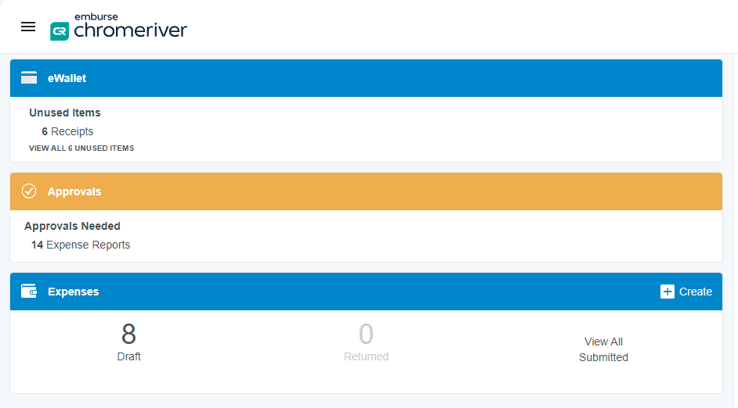
Chrome River
What information is on my dashboard?
e-Wallet –pictures taken with the CR Snap app are stored here. They remain in the eWallet until used in an expense report.
Approvals – if you are an approver, this section displays the number of expense reports that you need to approve.
Expenses – this is where expense reports are stored.

Slide 19
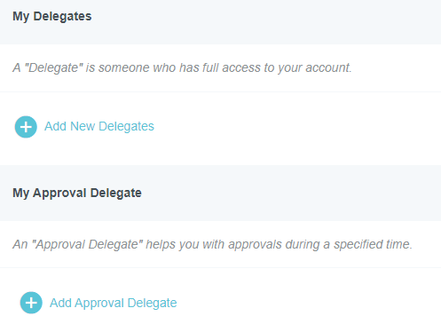
Chrome River
What is a delegate?
Delegate – is someone who has full access to your account.
Approval Delegate – is someone who helps you with approvals during a specified time.
How do I add a Delegate or an Approval Delegate?
Click on the dropdown box by your name.
Click on Account Settings
Click on the + button for Add New Delegates or Add Approval Delegate
Search for the name of the employee to be added and click on their name. Approval Delegates must be assigned a Start Date and End Date.

Slide 20
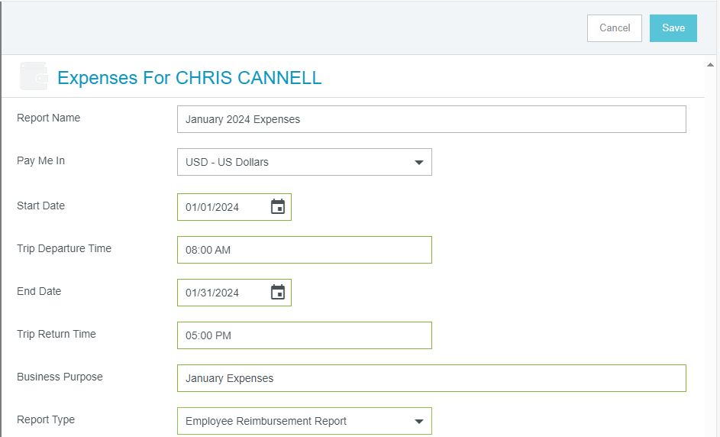
Chrome River
How do I create an expense report at the beginning of each month?
From your dashboard, in the Expenses section, click the +Create
Fill in the following:
Assign a report name: (e.g., January 2024 Expenses)
Enter State & End Date Range (e.g., 01/01/24 – 01/31/24)
Enter Trip Departure & Return Time (if entering expenses for the entire month, use your normal work hours e.g., 8:00 AM & 5:00 PM)
Business Purpose: use a generic name for the report cover purpose (e.g., January Expenses)
Report Type = Employee Reimbursement Report
Your expense report – draft is available in the Chrome River dashboard.
As you incur allowable expense, open the draft and use the + button to add reimbursement items (e.g., mileage, conference expenses, etc.)
At the end of the month, submit your expense report.

Slide 21
Chrome River
Adding Allowable Expenses
From the dashboard, click on Drafts and select the report.
Click the Open button
Click the + button to begin adding expenses.
Select the appropriate for each expense type.
Tips for recording mileage:
Round trip mileage in the same day? Click the “Return to Start” button to save time searching for the return destination.
Traveling to multiple locations in one day? Click the “Add Destination” button.

Slide 22
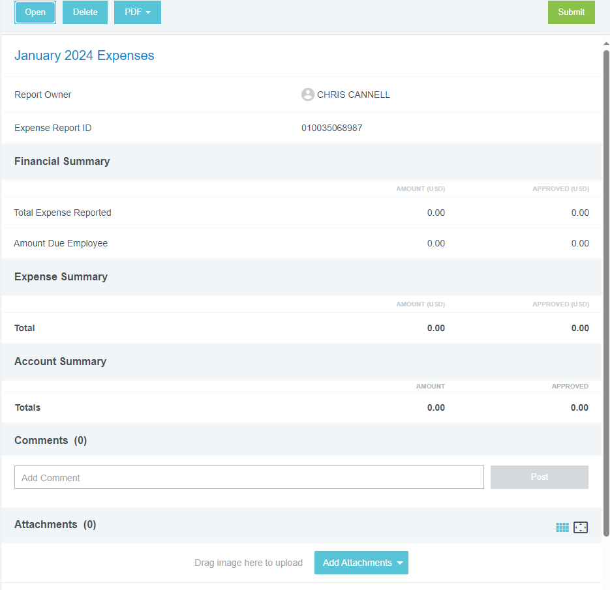
Chrome River
Required Documentation for Allowable Expenses
Expense Report Summary:
Conference Agenda – click the “Add Attachments” button on the first page of your expense report.
ATR – click the “Add Attachments” button on the first page of your expense report.
Failure to add the required conference agenda or ATR will result in the expense report being returned to the employee to add the documents, which will delay the process to issue reimbursement to the employee.

Slide 23
Chrome River
Required Documentation for Allowable Expenses
Each Separate Expense:
Travel-Related Itemized Receipts – for approved overnight trips (meals not provided by the conference, air fare, baggage fees, hotels, rental car, taxi/rideshare).
Other Itemized Receipts – for supplies, professional membership dues, conference fees, business meals (agenda & list of attendees is required for business meals).
Select the tile related to the type of expense.
Add the details for the expense.
Click the “Add Attachments” button to add the itemized receipt. If applicable for business meals, attach the agenda and list of attendees.
Note: Failure to add the required itemized receipts and documentation will result in the expense report being returned to the employee to add the documents, which will delay the process to issue reimbursement to the employee.

Slide 24
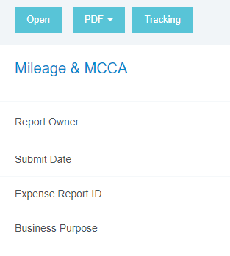
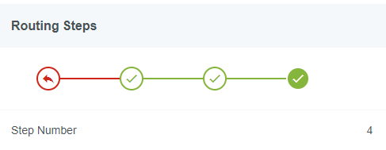
Chrome River
Tracking your expense report
Not sure where your report is in the approval process?
Click on the “Submitted” reports on your Dashboard.
Select the report in question.
The summary of the report is listed on the first page and includes the prior approvers.
Need additional detail? click the “Tracking” button. The routing steps are displayed. If all check marks are green, then your expense report is fully approved.

Slide 25
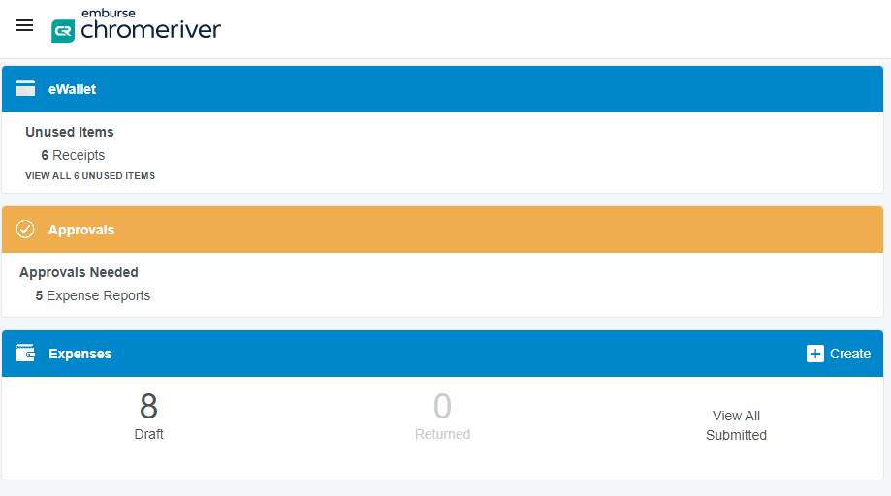
Chrome River
Approving an expense report
To review and approve expense reports:
Use the “Approve” button in the email to sent to you, OR
Log in on your OTC computer to approve expense report(s), OR
Use the Chrome River app on your phone to approve expense report(s).
If a correction needs to be made, click the “Return” button and add a note. The report will be sent back to the employee to make the correction.

Slide 26
Reimbursement & Chrome River Training
Thank you for joining us today!
Policy 6.12 – Direct Reimbursement of Permissible Expenditures Questions?
Email: finance@otc.edu
Chrome River Assistance – Employee Expense Reporting Questions?
Email: chromeriver@otc.edu

